Slide 1

Who is caring for the carer?
Early identification of unpaid carers to improve outcomes in Bath and North East Somerset
Notes:
Welcome and thank you for joining us today.
This session is about recognising unpaid carers earlier, understanding why that matters, and helping professionals across health, social care, education and the third sector feel more confident identifying carers and connecting them with support.
Many carers remain invisible to services for years. Often people don’t identify themselves as carers — they see themselves simply as a partner, parent, child, friend or neighbour doing what needs to be done.
But without recognition and support, caring responsibilities can quickly affect physical health, emotional well-being, employment, education, financial stability and family relationships.
What we also know is that early identification changes outcomes — not only for carers themselves, but also for the people they care for and for the services supporting them.
Today we’ll introduce the support available through BANES Carers’ Centre, explore how to recognise carers earlier, and discuss how your role can make a significant difference.

Slide 2

If you look after someone,
Who looks after you?
Many unpaid carers never ask for help — because they don’t realise support exists or that they’re in a caring role.
Recognising carers early can help prevent crisis down the line.
Most of us will care,
or be cared for, at some point in our lives
Notes:
Many people spend a significant part of their lives caring for a family member, friend, partner, or neighbour.
In fact, most of us will become an unpaid carer at some point in our lives.
The challenge is that many carers do not recognise themselves as carers. They often see what they do simply as being a parent, spouse, son, daughter, friend, or neighbour. Because of this, they may never seek support or realise that help is available.
As caring responsibilities increase, carers can become isolated, exhausted, financially strained, or overwhelmed. Often they put the needs of the person they care for ahead of their own health and wellbeing.
This is where professionals can make a real difference. By recognising the signs of caring responsibilities and having simple conversations, we can help carers identify themselves and access support earlier.
Early identification is important because it can prevent issues from escalating into crisis. When carers receive the right support, they are more able to maintain their own wellbeing, continue in their caring role, and achieve better outcomes for themselves and the person they care for.

Slide 3
Who are unpaid carers?
An unpaid carer provides support to someone who could not manage without their help. The carer might be an adult. They might be a child.
Many carers do not identify themselves as carers. They may see themselves as:
“Just a daughter”
“Just helping my partner”
“Just being a parent”
There are 20,000 unpaid carers in BaNES, nearly 10% of the population
This means carers are often hidden in plain sight.
Notes:
When we talk about unpaid carers, many people imagine someone providing intensive full-time care.
But unpaid caring is often much broader — and much less visible — than that.
An unpaid carer is someone who provides regular support to a family member, friend, partner, neighbour, or child who could not manage without that help.
This support might be due to illness, disability, mental health challenges, addiction, or age-related needs.
Many carers don’t identify with the term ‘carer’. Instead, they often describe themselves as ‘just a daughter,’ ‘just helping my partner,’ or ‘just being a parent.’
They see the support they provide as part of their relationship rather than as a caring role.
Because of this, carers are often hidden in plain sight. They may not realise they are entitled to support, information, or services that could help them in their caring role.
In BANES, there are around 20,000 unpaid carers, representing nearly 10% of the population. This highlights how common caring is and why it’s important for professionals, organisations, and communities to recognise carers and help them access support early.

Slide 4


A carer is anyone – child or adult – who provides support to someone who could not manage without them
Personal care
Physical care
Financial care
Administrative care
Emotional care
And much more
School Holiday Activities
519 young carer attendances
Notes:
When we think about carers, many people still picture a very narrow image of caring.
But unpaid carers come from every background, every community and every age group.
They may be:
children,
parents,
partners,
neighbours,
friends,
working professionals,
or older adults caring for each other.
Many remain hidden in plain sight because the support they provide is seen as part of everyday family life.
But caring often involves much more than people realise.
It can include:
personal care,
emotional support,
supervising someone for safety,
managing appointments and medication,
dealing with finances or paperwork,
advocacy,
or being constantly available emotionally.
Many carers are balancing this alongside:
employment,
parenting,
education,
or their own health needs.
Importantly, many carers are already in contact with services — but nobody has recognised them as carers yet.
That means professionals across all sectors have a vital role in identifying carers earlier and connecting them with support before things reach crisis point.

Slide 5
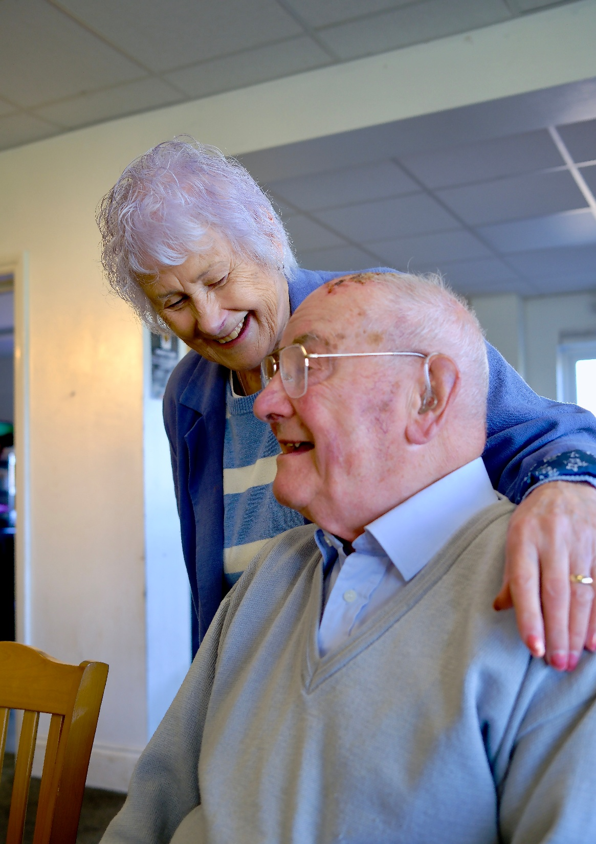
What do carers do?
Many carers provide complex support every day — often alongside their own paid work, education, and parenting — while managing their own mental and physical health.
Examples of day-to-day tasks include:
Personal and physical care
Emotional support
Managing medication
Coordinating appointments and services
Advocacy and communication with professionals
Managing finances and household responsibilities
Supporting mental health and recovery
Notes:
Many people think caring is simply helping with a few practical tasks, but for many carers, the role is complex, demanding, and ongoing. They often provide support alongside work, education, raising a family, or managing their own health conditions.
The support carers provide can include personal and physical care, such as helping someone wash, dress, eat, or move around safely. They also provide significant emotional support, offering reassurance, companionship, and helping someone cope with difficult circumstances.
Many carers are responsible for managing medication, monitoring symptoms, and ensuring treatment plans are followed. They frequently coordinate appointments, organise services, and navigate health and social care systems on behalf of the person they support.
Carers often act as advocates too, communicating with professionals, sharing important information, and ensuring the person's voice and needs are heard.
In addition, carers may take responsibility for managing finances, household tasks, shopping, transport, and other practical aspects of daily life.
For those supporting someone with mental health challenges, carers may play a vital role in recovery by providing stability, encouragement, and ongoing support during difficult periods.
The key message is that caring is often much more than people realise. It can involve a combination of physical, emotional, practical, and administrative responsibilities that require considerable time, skill, and resilience.

Slide 6
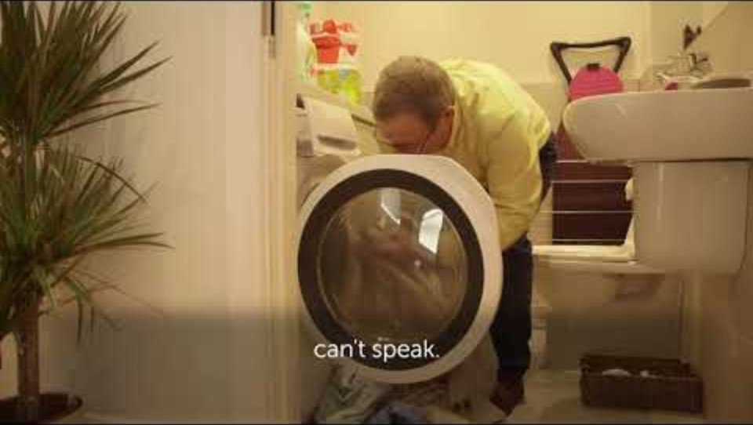

Slide 7

Why does early identification and support matter?
Recognising a caring role early on improves outcomes not just for carers, but for the people they support:
Better outcomes for carers and families
Reduced risk of crisis and breakdown for the carer
Earlier access to support and prevention
Reduced pressure on health and social care services
Improved patient/client engagement
Stronger multi-agency working
Notes:
Early identification is not simply about recognising carers — it’s about improving outcomes across the whole system.
When carers are recognised and supported early, we are far more likely to prevent situations escalating into crisis.
That benefits:
carers themselves,
the people they support,
professionals,
and wider services.
Early support can:
reduce breakdown in caring arrangements,
improve wellbeing and resilience,
increase engagement with services,
strengthen partnership working,
and reduce pressure on health and social care systems.
We also know that carers often play a vital role in:
maintaining stability,
preventing hospital admissions,
supporting recovery,
and helping people remain independent for longer.
When carers are struggling without support, the risk of crisis increases significantly.
But small interventions early on —
sometimes simply recognising someone as a carer and connecting them to support —
can make a substantial difference.
This is why professionals in every sector have an important role in identifying carers as early as possible.

Slide 8
What happens when carers are supported?
When carers are supported, they are more likely to:
Think:
“My identification/referral can directly contribute to these outcomes.”
Maintain their own health and wellbeing
Continue in education or employment
Feel confident navigating services
Sustain caring relationships longer
Experience less isolation and stress
Seek help sooner
Improve outcomes for the person they care for
Early identification and referral allows carers to access support before reaching crisis point.
Many carers say: “being recognised and listened to is the first step in feeling supported.”
Notes:
When carers are recognised and supported early, the outcomes can be significant — both for the carer and for the person they support.
Support helps carers feel:
less isolated,
more informed,
more confident,
and better able to continue in their caring role safely and sustainably.
It can also help carers:
maintain their own physical and mental health,
remain in education or employment,
navigate services more effectively,
and seek support earlier before situations escalate.
Importantly, when carers are supported, outcomes often improve for the person receiving care as well.
Stable, informed and supported carers are better able to:
maintain caring relationships,
support recovery,
advocate effectively,
and help prevent crisis situations.
For professionals, this is an important message:
your conversation, recognition or referral may be the first step toward preventing a carer from reaching crisis point.
Sometimes a simple question, acknowledgement or signpost to support can make a substantial difference.

Slide 9
How does The Carers’ Centre
support unpaid carers?
We work alongside professionals to identify, support and advocate for unpaid carers across Bath and North East Somerset.
92%
166
Registered local charity supporting unpaid carers across B&NES since 1998
Trusted partner within the Carers Trust network
Commissioned by B&NES Council to deliver carers’ support services
Supporting young carers, adult carers, and older carers from age 5+
Working with health, education, social care and community organisations
Notes:
The Carers’ Centre provides dedicated support for unpaid carers across Bath and North East Somerset.
We work closely alongside professionals across:
health,
social care,
education,
community services,
and the voluntary sector
to help identify carers early and connect them with appropriate support.
Our role is not only to support carers when they are already in crisis, but ideally to reach carers earlier — before caring responsibilities begin to significantly affect their health, wellbeing, education, employment or family life.
We support carers aged 5 and above, including:
young carers,
adult carers,
parent carers,
working carers,
and older carers.
We are commissioned by B&NES Council and are part of the wider Carers Trust network, which helps ensure joined-up support and best practice.
Most importantly, we want professionals to feel confident identifying carers and referring them to our service — because timely support can make a significant difference to long-term outcomes.

Slide 10
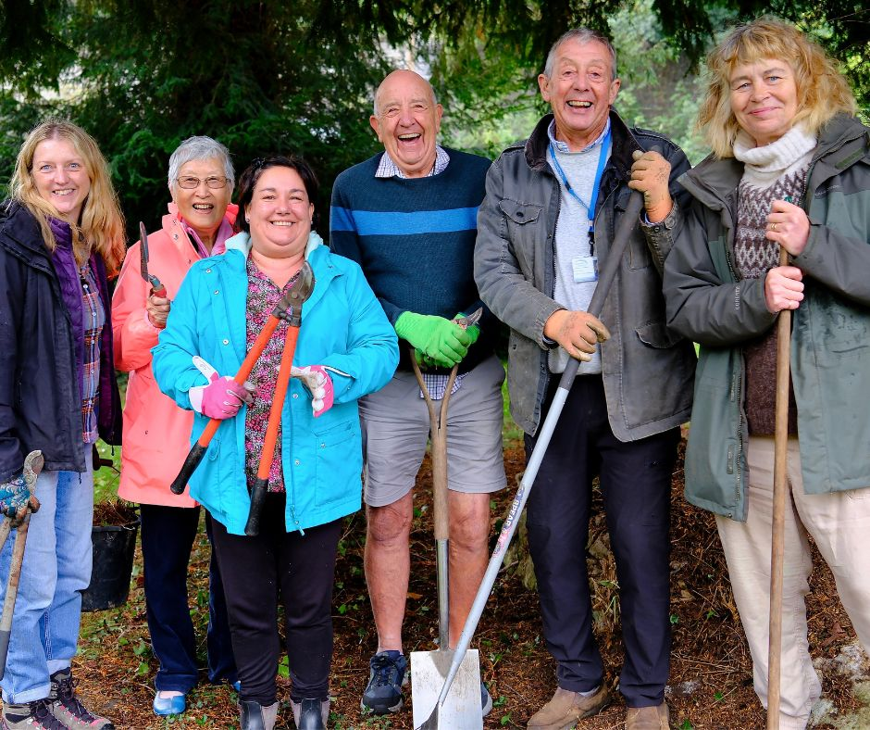
How do we support unpaid carers?
Support
Wellbeing
Annual Investment
Information, advice and support line
Individual support plans
Emergency contingency planning (“My Caring Role”)
Financial and grant support
Young Carers' need assessments
Peer support and carer cafés
Social connection and wellbeing activities
Groups and workshops
Bereavement support
Participation
Carers’ Voice and lived experience engagement
Training and awareness
Young Carers' Council
We work alongside professionals to provide early intervention, emotional support, practical advice and wellbeing opportunities for carers.
Notes:
The Carers’ Centre provides a wide range of support designed to meet carers’ practical, emotional and wellbeing needs at different stages of their caring journey.
Our Support Team provides:
information and advice,
support planning,
Young carer needs assessments
emergency planning,
and practical guidance, including support accessing grants and services.
This early support can often reduce stress and help carers feel more informed and prepared.
Our Wellbeing Team focuses on reducing isolation and improving emotional wellbeing through:
peer support,
carer cafes,
activities,
social groups,
and bereavement support.
For many carers, simply connecting with others who understand their experiences can have a significant impact on confidence and resilience.
Our Participation Team ensures carers have opportunities to influence services and share their experiences through initiatives such as the Carers’ Voice and young carers' council.
We also provide training and engagement opportunities for professionals to help improve identification and understanding of unpaid carers across services.
Overall, our aim is to provide preventative, person-centred support that helps carers remain connected, informed and supported before situations escalate into crisis.

Slide 11
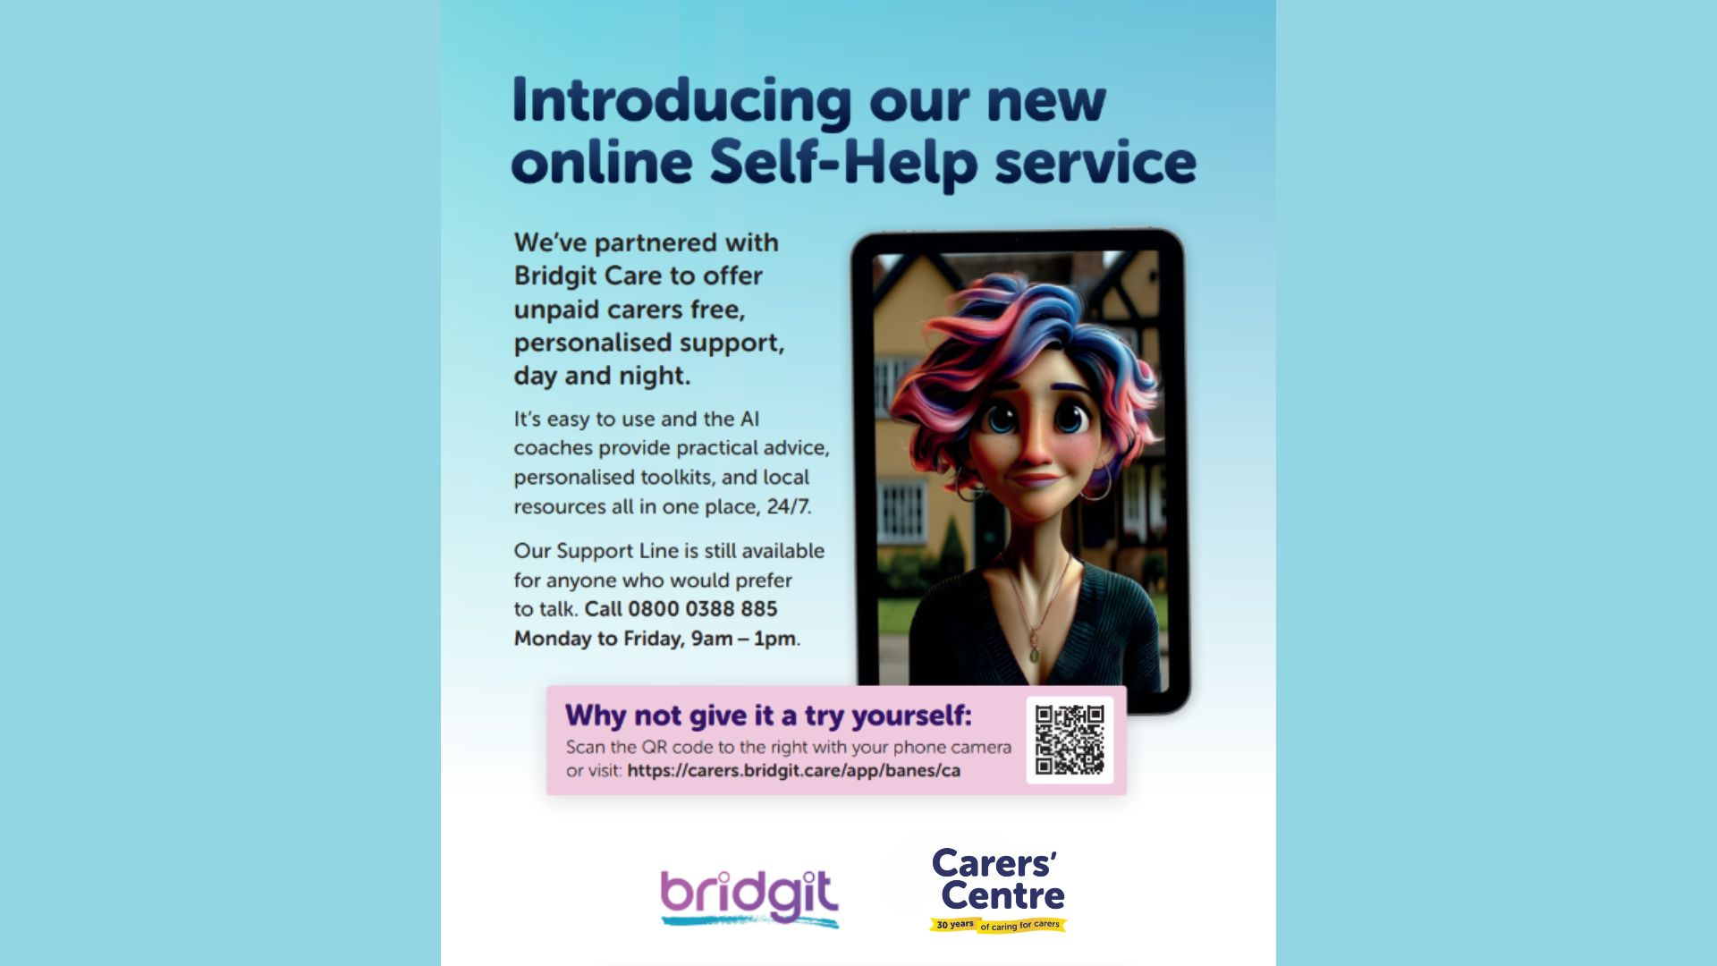
Notes:
Bridgit, our new AI-powered support tool designed specifically for unpaid carers.
We know that caring responsibilities don't always fit into office hours. Questions, worries, and challenges can arise at any time of the day or night.
Bridgit provides carers with immediate access to information, guidance, and emotional support whenever they need it.
The tool is available 24 hours a day, 7 days a week, and can support carers in multiple languages, helping to remove some of the barriers that prevent people from accessing support. It offers practical advice on topics such as benefits, caring responsibilities, wellbeing, and navigating services, while also providing a space where carers can talk through concerns and receive tailored guidance.
Importantly, Bridgit does not replace the support provided by the Carers' Centre or other professionals. Instead, it complements our services by providing another accessible route to help, particularly for carers who may be unable to attend appointments, feel uncomfortable asking for support, or simply need information outside normal working hours.
For professionals, Bridgit can be a useful resource to recommend when working with carers who need immediate support, additional information, or a flexible option that fits around their caring role.
The QR code on the slide takes carers directly to the platform, making it easy to get started and explore the support available.

Slide 12

Why reach more carers?
£20,000 - £40,000
With support, carers can:
reduce isolation
improve wellbeing
access financial support
feel more confident navigating services
sustain caring relationships
prevent crisis escalation
We have 7,000 carers registered with us. How can we work together to identify the hidden 13,000?
There are around 20,000 unpaid adult carers in BaNES – around 10% of the population
£162 billion economic value - equivalent to a second NHS (£146 million in BaNES)
Notes:
Support for unpaid carers matters to both individuals and the wider community.
With the right support in place, carers are often better able to maintain their own wellbeing while continuing in their caring role. Support can help reduce isolation, improve confidence, and make it easier to navigate services and access financial help that they may not realise they are entitled to.
Importantly, early support can also help prevent situations from reaching crisis point. When carers feel supported and informed, caring relationships are more sustainable and outcomes are generally better for everyone involved.
In BaNES, there are an estimated 20,000 unpaid carers, which is around 10% of the population. However, only around 7,000 carers are currently registered with the Carers’ Centre. That means there may be around 13,000 ‘hidden carers’ who are not yet accessing support or identifying themselves as carers.
This is why partnership working is so important. Professionals across health, education, social care, and community services all play a key role in helping identify carers early and connecting them with support.
It’s also worth recognising the enormous contribution unpaid carers make economically and socially. Across the UK, unpaid care is estimated to be worth around £162 billion annually — often described as equivalent to providing a second NHS. In BaNES alone, that contribution is estimated at around £146 million.
These figures remind us that supporting carers is not only the right thing to do for individuals and families — it is also essential for the sustainability of health and care services.

Slide 13
What does supporting unpaid carers
look like in practice?
1. Think ‘carer’!
Many carers do not identify themselves as carers.
2. Treat carers as ‘expert partners’
Recognise their knowledge and lived experience.
3. Understand carers rights
Be aware of carers’ needs and entitlements.
4. Make services carer-friendly
Offer flexible appointments, good communication and consider accessibility requirements.
5. Mind your language
Carers are unpaid — not ‘informal’.
6. Be proactive
Carers rarely prioritise themselves. Offer referral and support as soon as possible and appropriate.
Notes:
There are several simple but important ways professionals can help improve outcomes for unpaid carers.
The first is simply to ‘think carer’.
Many carers do not identify themselves as carers, so professionals may need to ask gentle, curious questions about who provides support at home and how caring responsibilities are affecting someone’s wellbeing.
It’s also important to recognise carers as expert partners.
Carers often hold detailed knowledge about:
routines,
communication,
behaviour,
risks,
medication,
and changes in wellbeing.
Their lived experience is extremely valuable.
Professionals should also be aware of carers’ rights and the impact caring may be having on:
physical health,
emotional wellbeing,
education,
employment,
finances,
and social isolation.
Small adjustments can also make services more carer-friendly:
flexible appointments,
clear communication,
accessible information,
and recognising time pressures on carers.
Language matters too.
We encourage professionals to avoid terms like ‘informal carer’, which can unintentionally minimise the complexity and value of unpaid caring roles.
And finally, be proactive.
Carers often focus entirely on the person they support and may not seek help for themselves until they are overwhelmed.
A simple conversation, acknowledgement or referral can make a significant difference.

Slide 14
How can you help?
Recognise
Respond
Refer
Refresh
Recommend
Know how to identify an unpaid carer
Listen, validate and let them know support is available.
Refer unpaid carers to our support services via our professional referral form
Update your knowledge
Share learning and promote carer-aware practice within your organisation.
Notes:
This final section focuses on the practical role professionals can play in identifying and supporting unpaid carers.
Many carers remain hidden because they do not recognise themselves as carers, or they do not feel comfortable asking for help. Small actions from professionals can make a significant difference.”
Recognise
Be aware that carers can be anyone — children, parents, partners, friends, neighbours — and they may be providing emotional, physical, financial, or practical support every day.
Often carers will describe themselves as:
‘just helping out’
‘being a husband/wife’
or ‘just being a parent’
Professionals should stay curious and consider whether someone may have caring responsibilities when they talk about stress, exhaustion, missed appointments, or balancing multiple responsibilities.”
Respond
When someone shares their caring role, listening and validating their experience is important.
A simple response such as:
‘That sounds like a lot to manage’
or
‘There is support available for carers’
can help carers feel seen and understood.
Many carers are used to focusing entirely on the person they care for, so they may not think about their own wellbeing.”
Refer
Early referral can prevent carers from reaching crisis point.
Professionals do not need to solve every issue themselves — simply connecting carers with specialist support can improve outcomes significantly.
The Carers’ Centre can provide:
practical guidance,
emotional support,
wellbeing opportunities,
information on rights and entitlements,
and ongoing support tailored to the carer’s situation.
Refresh
Carers’ rights, local services, and available support can change over time, so continuing to update knowledge and awareness is important.
Keeping carers visible within professional practice helps create more carer-aware services.
And finally, recommend.
Share learning with colleagues and encourage carer-aware approaches within teams and organisations.
Sometimes the biggest impact comes from normalising conversations about caring responsibilities and making identification part of everyday practice.
Every professional has the opportunity to identify hidden carers earlier.
Recognising carers, responding compassionately, and referring them to support can improve outcomes not only for carers themselves, but also for the people they care for.
Small conversations can make a lasting difference.

Slide 15
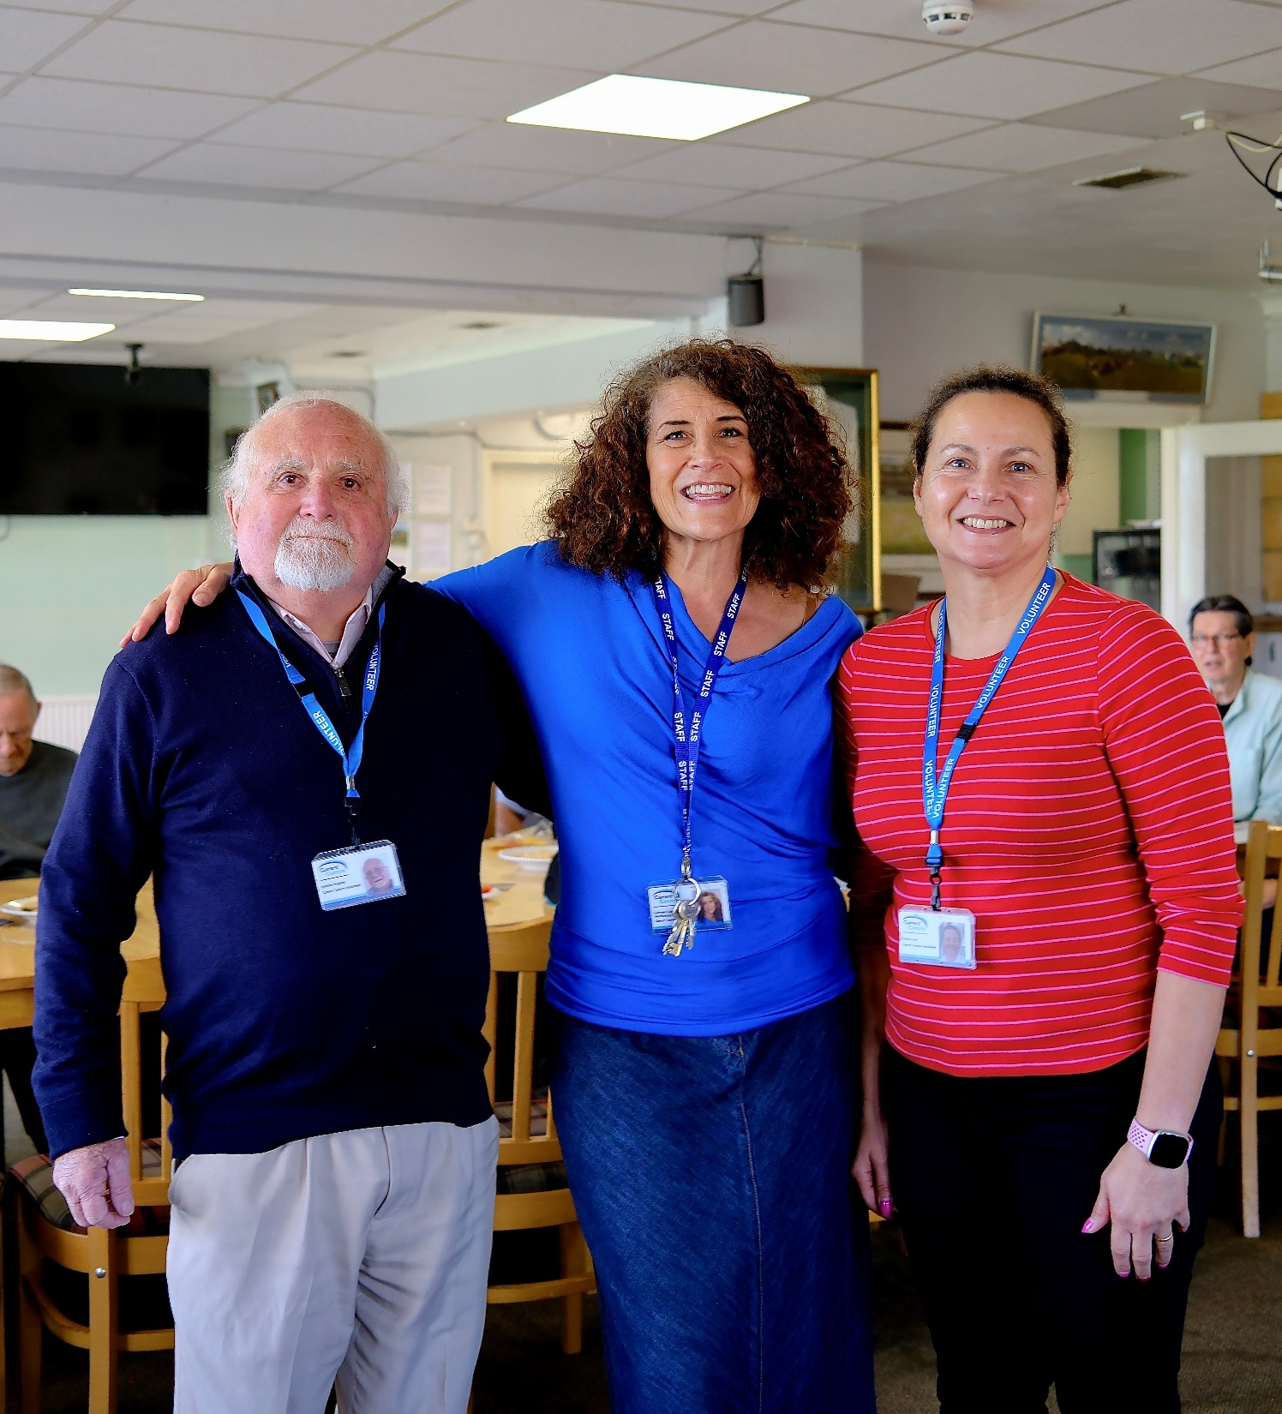
How to refer:
Professionals can refer carers to us directly via our website:
https://banescarerscentre.org.uk/for-professionals/adult-carers-referral-form/
Or use the CWH Professional form
Reassign pathway on RIVIAM.
Carers can sign up themselves on the website or by giving us a call.
Notes:
How can professionals can refer unpaid carers to The Carers’ Centre and how carers can also access support independently.
The referral process is designed to be straightforward and accessible, helping carers connect with support as early as possible.
Professionals can refer carers directly through our online referral form.
This is often appropriate when:
a carer is struggling emotionally or practically,
they would benefit from additional support,
or they may not feel confident reaching out themselves.
A referral can open the door to information, guidance, well-being support, peer connection, and practical assistance.
You do not need to have all the answers before making a referral.
Even a simple conversation that recognises someone as a carer and offers support can have a meaningful impact.
Early referrals can help prevent carers reaching crisis point and reduce pressure on wider services.
Carers can also contact us directly themselves.
Some carers may prefer:
completing the online form independently,
speaking to someone over the phone,
or accessing information at their own pace.
Offering different ways to access support helps reduce barriers and encourages engagement.
The Community Wellbeing Hub professional form provides another route for connecting people with wider support services.
This can be particularly useful when carers are experiencing:
social isolation,
financial pressure,
housing concerns,
or wellbeing challenges alongside their caring role.”
Reassign pathway on RIVIAM
For teams using RIVIAM pathways, reassignment options can help ensure carers are directed to the most appropriate support service quickly and efficiently.
This supports joined-up working between organisations and helps avoid carers falling through gaps in services.
If you identify someone who may be an unpaid carer, encourage them to seek support early — even if they feel they are ‘coping’.
Many carers wait until they are overwhelmed before asking for help.

Slide 16
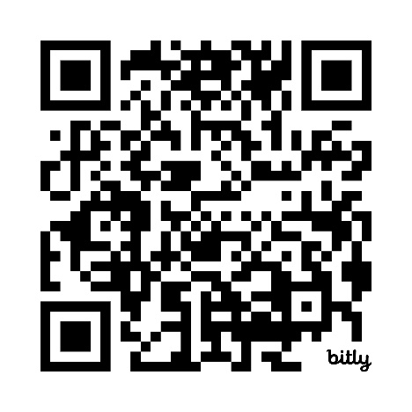
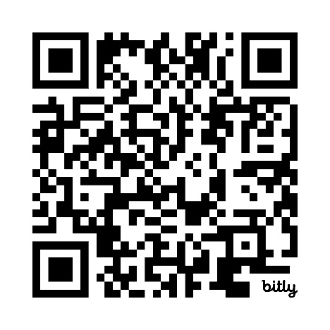
QR referral form links:
banescarerscentre.org.uk/for-professionals/adult-carers-referral-form/
banescarerscentre.org.uk/for-professionals/young-carer-referral-form/
Refer an adult carer
Refer a young carer
Notes:
The QR codes and links provide quick access to the online referral forms, making it easier for professionals to connect carers with support quickly and efficiently.
Adult carers
Adult carers may be supporting:
a partner,
parent,
adult child,
friend,
or neighbour.
Young carers
It is also important to remember that carers can be children and young people.
Young carers may support someone in the home due to:
illness,
disability,
mental health difficulties,
or substance misuse.
Early identification is especially important for young carers so they can access the right support as soon as possible.
If you are unsure whether someone would benefit from support, it is still worth having the conversation and exploring referral options.
A referral does not place pressure on the carer — it simply opens access to information, guidance, and support.
These QR codes can be scanned directly by professionals or shared with carers who may wish to self-refer.

Slide 17

Stay in the loop:
Keep up to date with news and services from The Carers’ Centre
Notes:
Staying connected and keep carers on your radar after today.
We know professionals are incredibly busy, and guidance, referral pathways, and local support offers can change quickly. Our professional e-news is designed to make it easy for you to stay informed without adding extra workload.
By signing up, you’ll receive:
Updates on services and support available for unpaid carers
Information about training opportunities and events
Changes to referral pathways and local resources
Awareness campaigns and carers-focused initiatives
Practical tools and resources you can use in your role
It’s also a helpful way to keep carer awareness active within your team and organisation. Sometimes a short update or reminder is all it takes for a professional to recognise a hidden carer and start an important conversation.
The QR code on the screen will take you directly to the sign-up page. It only takes a moment to register, and we’d really encourage you to join so we can continue working together to identify and support unpaid carers earlier.
Please also feel free to share the sign-up link with colleagues and teams who may benefit from these updates.

Slide 18

Freephone Support Line
0800 0388 885
Monday – Friday, 9am – 1pm
support@banescarerscentre.org.uk
Notes:
One of the key ways we support unpaid carers is through our Freephone Support Line.
Our Support Line is open Monday to Friday, from 9am until 1pm, and it’s available not only for unpaid carers themselves, but also for professionals who may need advice, guidance, or support around a caring situation.
Professionals often contact us when they’re unsure whether someone identifies as a carer, when they want advice about available support, or when they’d like guidance on making a referral. We’re always happy to have those conversations.
For unpaid carers, the Support Line can be the first step in accessing emotional support, practical advice, benefits guidance, wellbeing opportunities, or ongoing support from our team.
Sometimes carers don’t feel ready to complete an online form, so simply encouraging them to give us a call can make support feel more accessible and less overwhelming.
Please keep our number visible within your teams and services, and don’t hesitate to use the line yourselves if you need advice or want to discuss how best to support a carer.

Slide 19
Any questions?
Notes:
Any questions?

Slide 20




The Carers’ Centre is the operating name of Bath and North East Somerset Carers’ Centre registered in England and Wales.
Charity Registration Number: 1060080. Registered number 03289938.
Notes:
Thank you all for your time today.
We hope this session has helped highlight the important role professionals play in recognising and supporting unpaid carers early. Small conversations, simple questions, and timely referrals can make a huge difference to someone’s wellbeing and ability to continue caring safely and sustainably.
We’d encourage you to take away the key messages from today:
Think carer
Recognise carers early
Respond with empathy and understanding
Refer into support as soon as possible
Please remember that you are not expected to have all the answers — our role is to work alongside you and provide ongoing support for carers and professionals across B&NES.
We’d really value continuing to work in partnership with you, so please stay connected through our professional e-news, share information within your teams, and contact us whenever you need advice or guidance.
Thank you again for the work you do every day to support unpaid carers and the people they care for.
Are there any final questions before we finish?

