Slide 1

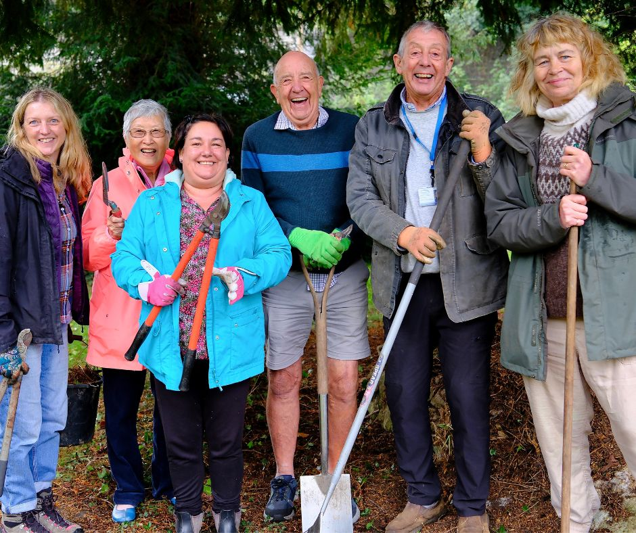

Introduction to Safeguarding for Volunteers
Self-Learning Tool
Our Values:

Slide 2
Safeguarding is everyone’s responsibility
As a volunteer, you play an important role in helping keep children and adults at risk safe. You are not expected to investigate concerns or decide whether abuse has occurred.
Your role is to:
Be aware of possible signs of abuse or neglect.
Listen if someone shares a concern.
Report any concerns promptly using our safeguarding procedure.
Help create a safe, respectful and inclusive environment.

Slide 3

What is Safeguarding?
Safeguarding means protecting people's health, wellbeing and human rights so they can live free from abuse, neglect and exploitation.
Children and adults at risk have the right to:
Feel safe.
Be treated with dignity and respect.
Be listened to.
Be protected from harm

Slide 4

Who can be vulnerable?
Older people
People with disabilities
Anyone with mental health conditions
Those receiving care and support
Those who are homeless
Those subjected to domestic abuse
Those who have experienced sexual abuse
Those subjected to trafficking or exploitation
Anyone who has drug or alcohol issues
People who have learning disabilities

Slide 5
Types of abuse
Physical abuse
Emotional abuse
Neglect
Sexual Abuse
Financial abuse
Institutional Abuse
Human Trafficking and modern slavery
Discriminatory
Self neglect
Domestic violence
Abuse can happen anywhere and may be carried out by anyone, including family members, friends, carers, professionals or strangers.

Slide 6
Types of abuse
Physical abuse:
Causing physical harm through hitting, shaking, pushing, inappropriate restraint, burns or misuse of medication.
Possible signs:
Unexplained injuries or repeated accidents.
Injuries with unlikely explanations.
Fear of certain people.
Wearing clothing to hide injuries.
Emotional or psychological abuse:
Behaviour that damages someone's emotional wellbeing, such as humiliation, threats, intimidation, controlling behaviour or bullying.
Possible signs:
Low confidence or self-esteem.
Anxiety or withdrawal.
Sudden changes in behaviour.
Fearfulness around particular people

Slide 7
Types of abuse
Sexual abuse:
Any sexual activity without consent or understanding, including grooming, exploitation or inappropriate touching.
Possible signs:
Sexualised behaviour that is unusual for the person's age.
Avoiding certain people or places.
Unexplained injuries.
Sudden changes in mood or behaviour.
Neglect:
Failing to meet someone's basic physical or emotional needs.
Possible signs:
Poor hygiene.
Inappropriate clothing.
Hunger or dehydration.
Untreated medical conditions.
Regular absence from activities.

Slide 8
Types of abuse
Financial abuse:
Stealing money or possessions, fraud, coercion or misuse of someone's finances.
Possible signs:
Missing belongings.
Unexplained lack of money.
Anxiety about finances.
Sudden changes to financial arrangements.
Discriminatory abuse:
Harassment or unfair treatment because of disability, race, religion, gender, age, sexuality or other protected characteristic protected characteristics.
Domestic abuse:
Any pattern of controlling, coercive, threatening or violent behaviour between people in a close relationship.

Slide 9

Types of abuse
Modern Slavery and Exploitation, including forced labour, criminal exploitation, sexual exploitation or human trafficking.

Slide 10
What might someone tell you?
A person may not say, "I'm being abused.“
Instead, they might say things like:
"I'm scared to go home."
"Please don't tell anyone."
"Someone keeps hurting me."
"I don't like being left with them."
"They take all my money."
"It's my fault."
They may also hint that something is wrong without giving full details.
Always take what someone tells you seriously.

Slide 11
What should you do?
✓ Stay calm.
✓ Listen carefully.
✓ Take what they say seriously.
✓ Allow them to speak in their own words.
✓ Reassure them that they have done the right thing by telling you.
✓ Explain that you will need to share the information with the appropriate safeguarding person to help keep them safe.
✓ Record what was said as soon as possible using their own words where you can.
✓ Report the concern immediately following our safeguarding procedure.

Slide 12
If someone makes a disclosure, a useful way to respond is:
Listen – Give them your full attention.
Reassure – "Thank you for telling me."
Explain – "I may need to share this with someone whose job it is to help keep people safe."
Record – Write down exactly what was said as soon as possible.
Report – Contact the Designated Safeguarding Lead immediately.
Recording Concerns
Include:
Date and time.
What you saw or heard.
The person's own words where possible.
Who was present.
Your name.
What action you took.
Keep records factual. Do not include assumptions or opinions.

Slide 13
What should you NOT do?
✗ Promise to keep it secret.
✗ Ask leading or investigative questions.
✗ Press for more information than they want to give.
✗ Express shock, disbelief or anger.
✗ Confront the person who may have caused the harm.
✗ Investigate the concern yourself.
✗ Delay reporting because you are unsure.

Slide 14
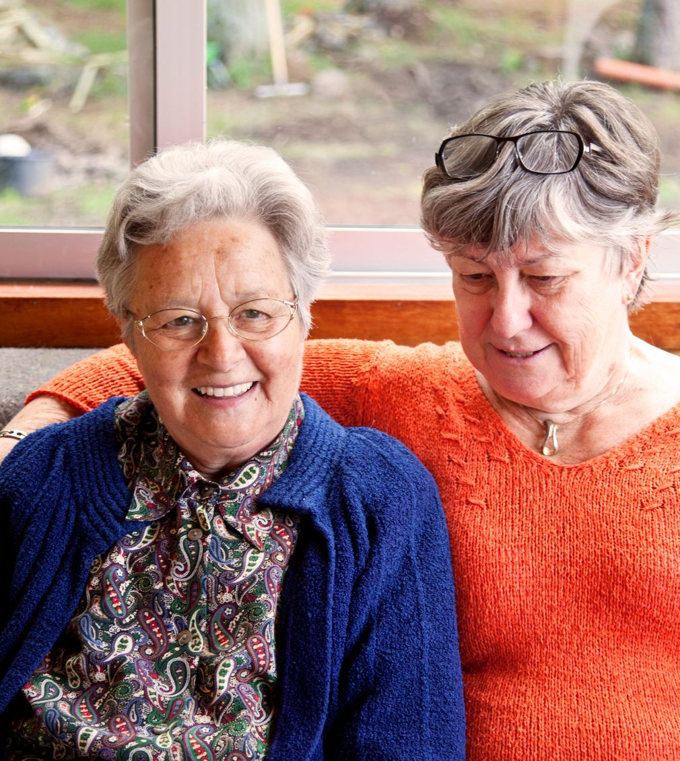
In the event of a disclosure, the first step is to contact the lead staff organizer for the activity.

Slide 15
Neglect and Acts of Omission, accounting for 32% of risks.
Family carers, while providing essential support, are also at risk of abuse from the people they care for, or neglect, and can face safeguarding challenges themselves.
Remember:
You do not need proof that abuse has happened.
You do not need to investigate.
If you are worried about someone's safety, report it. It is always better to share a concern than to keep it to yourself.
Thank you for helping us create a safe, welcoming environment for everyone.

Slide 16
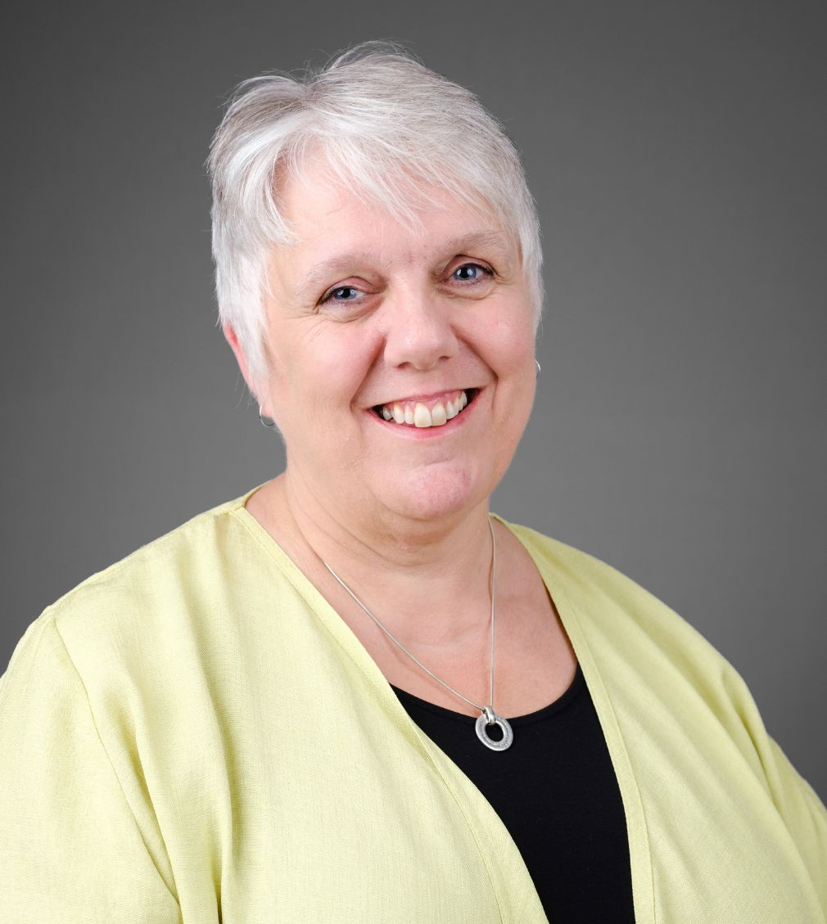
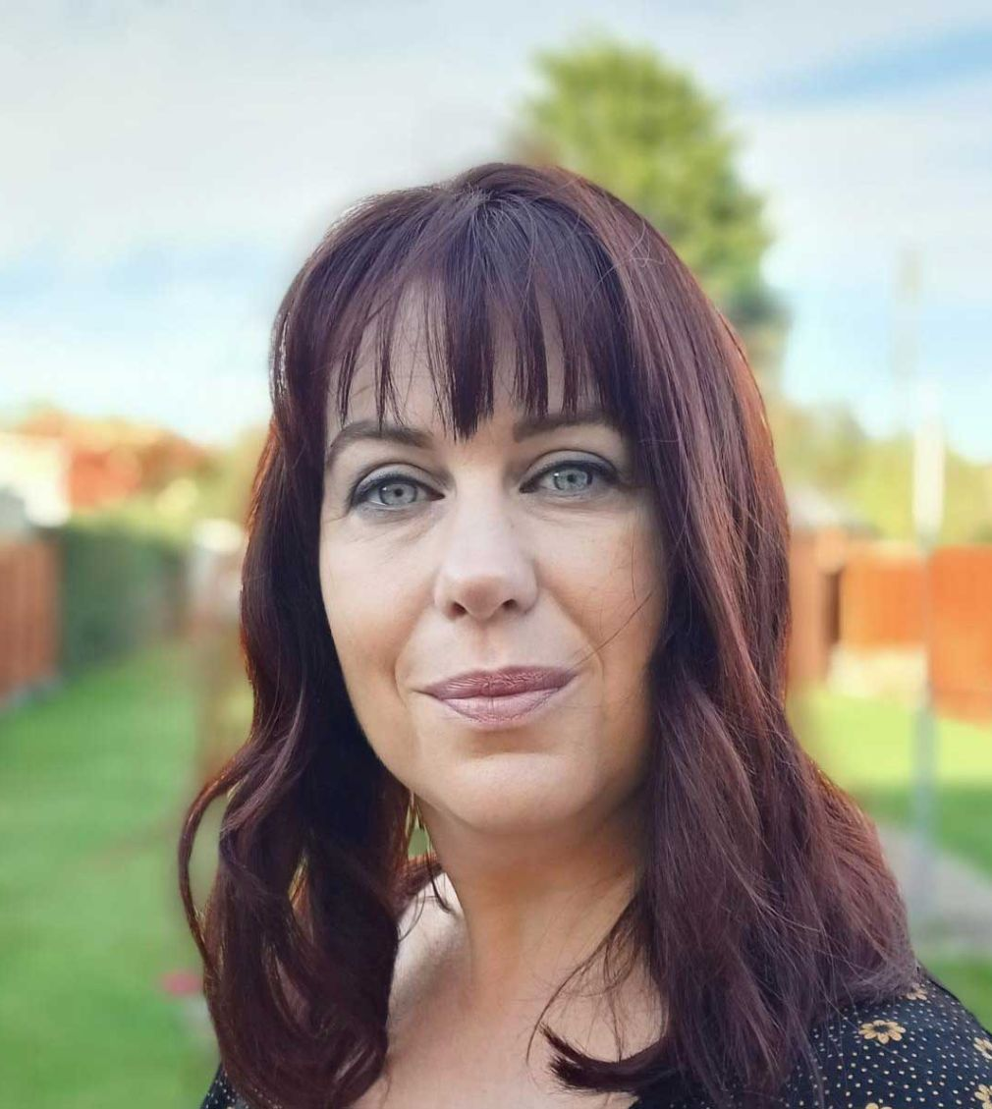

Safeguarding Leads at The Carers’ Centre
Jacqui Orchard
Safeguarding Lead Adults and Young People
Claire Abrahams
Safeguarding Lead Adults and Young People
Sophie Kiernon
Safeguarding Lead Adults

Slide 17
Whistleblowing Overview
Whistleblowing is the reporting of suspected wrongdoing
The Carers’ Centre policy encourages individuals covered by the policy to report suspected wrongdoing as soon as possible, in the knowledge that their concerns will be taken seriously
Concerns raised via CEO if informal channels not successful.
Other external options available (see policy)

Slide 18
Confidentiality and Safeguarding
A clients right to confidentiality is not absolute and may be overridden where there is evidence that sharing information:
• Is necessary to support a criminal investigation or prosecution.
• Is in the public interest (such as in the interests of public safety or the safety of other vulnerable people or children).
• Is in the best interest of a person who lacks the capacity to decide on whether information should be shared to manage their risk of abuse.
• Where it is safe to do so, we always tell a person if we are going to break their confidentiality

Slide 19



For more information, please contact our Volunteer Officer on 0800 0388 885 or email volunteer@banescarerscentre.org.uk
Please let us know when you have completed this presentation.
The Carers’ Centre is the operating name of Bath and North East Somerset Carers’ Centre registered in England and Wales.
Charity Registration Number: 1060080. Registered number 03289938.

